Slide 1

Basic Details of the Team and Problem Statement
Team ID : UIA509
Theme : Health & Hygiene
Problem Statement Title: Develop a software tool/app which can diagnose cardiomegaly from digital chest Xray
Team Name: X-Healers
Team Leader Name: Sakshi Nasha (IND-1-064)

Slide 2

Team Member Details
Team Leader Name: Sakshi Nasha Participant ID: IND-1-064
Team Member 1 Name: Sarthak Shukla Participant ID: IND-1-115
Team Member 2 Name: Taha Fakhech Participant ID: IND-1-115
Team Member 3 Name: Milton Jeque Participant ID: IND-1-115
Team Member 4 Name: Gabriel Ndimulunde Participant ID: IND-1-115
Team Member 5 Name: Ramatou Salah Hassane Participant ID: IND-1-115
Team Mentor 1 Name: Ansh Tyagi Mentor ID:MENT073
Team Mentor 2 Name: Govind T Mentor ID:MENT178

Slide 3
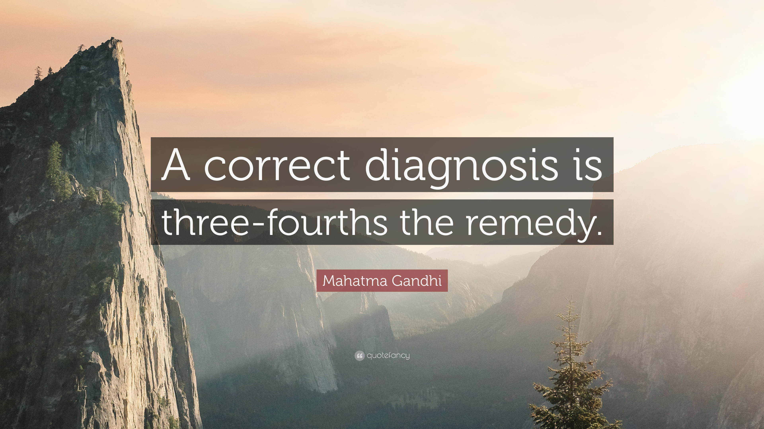
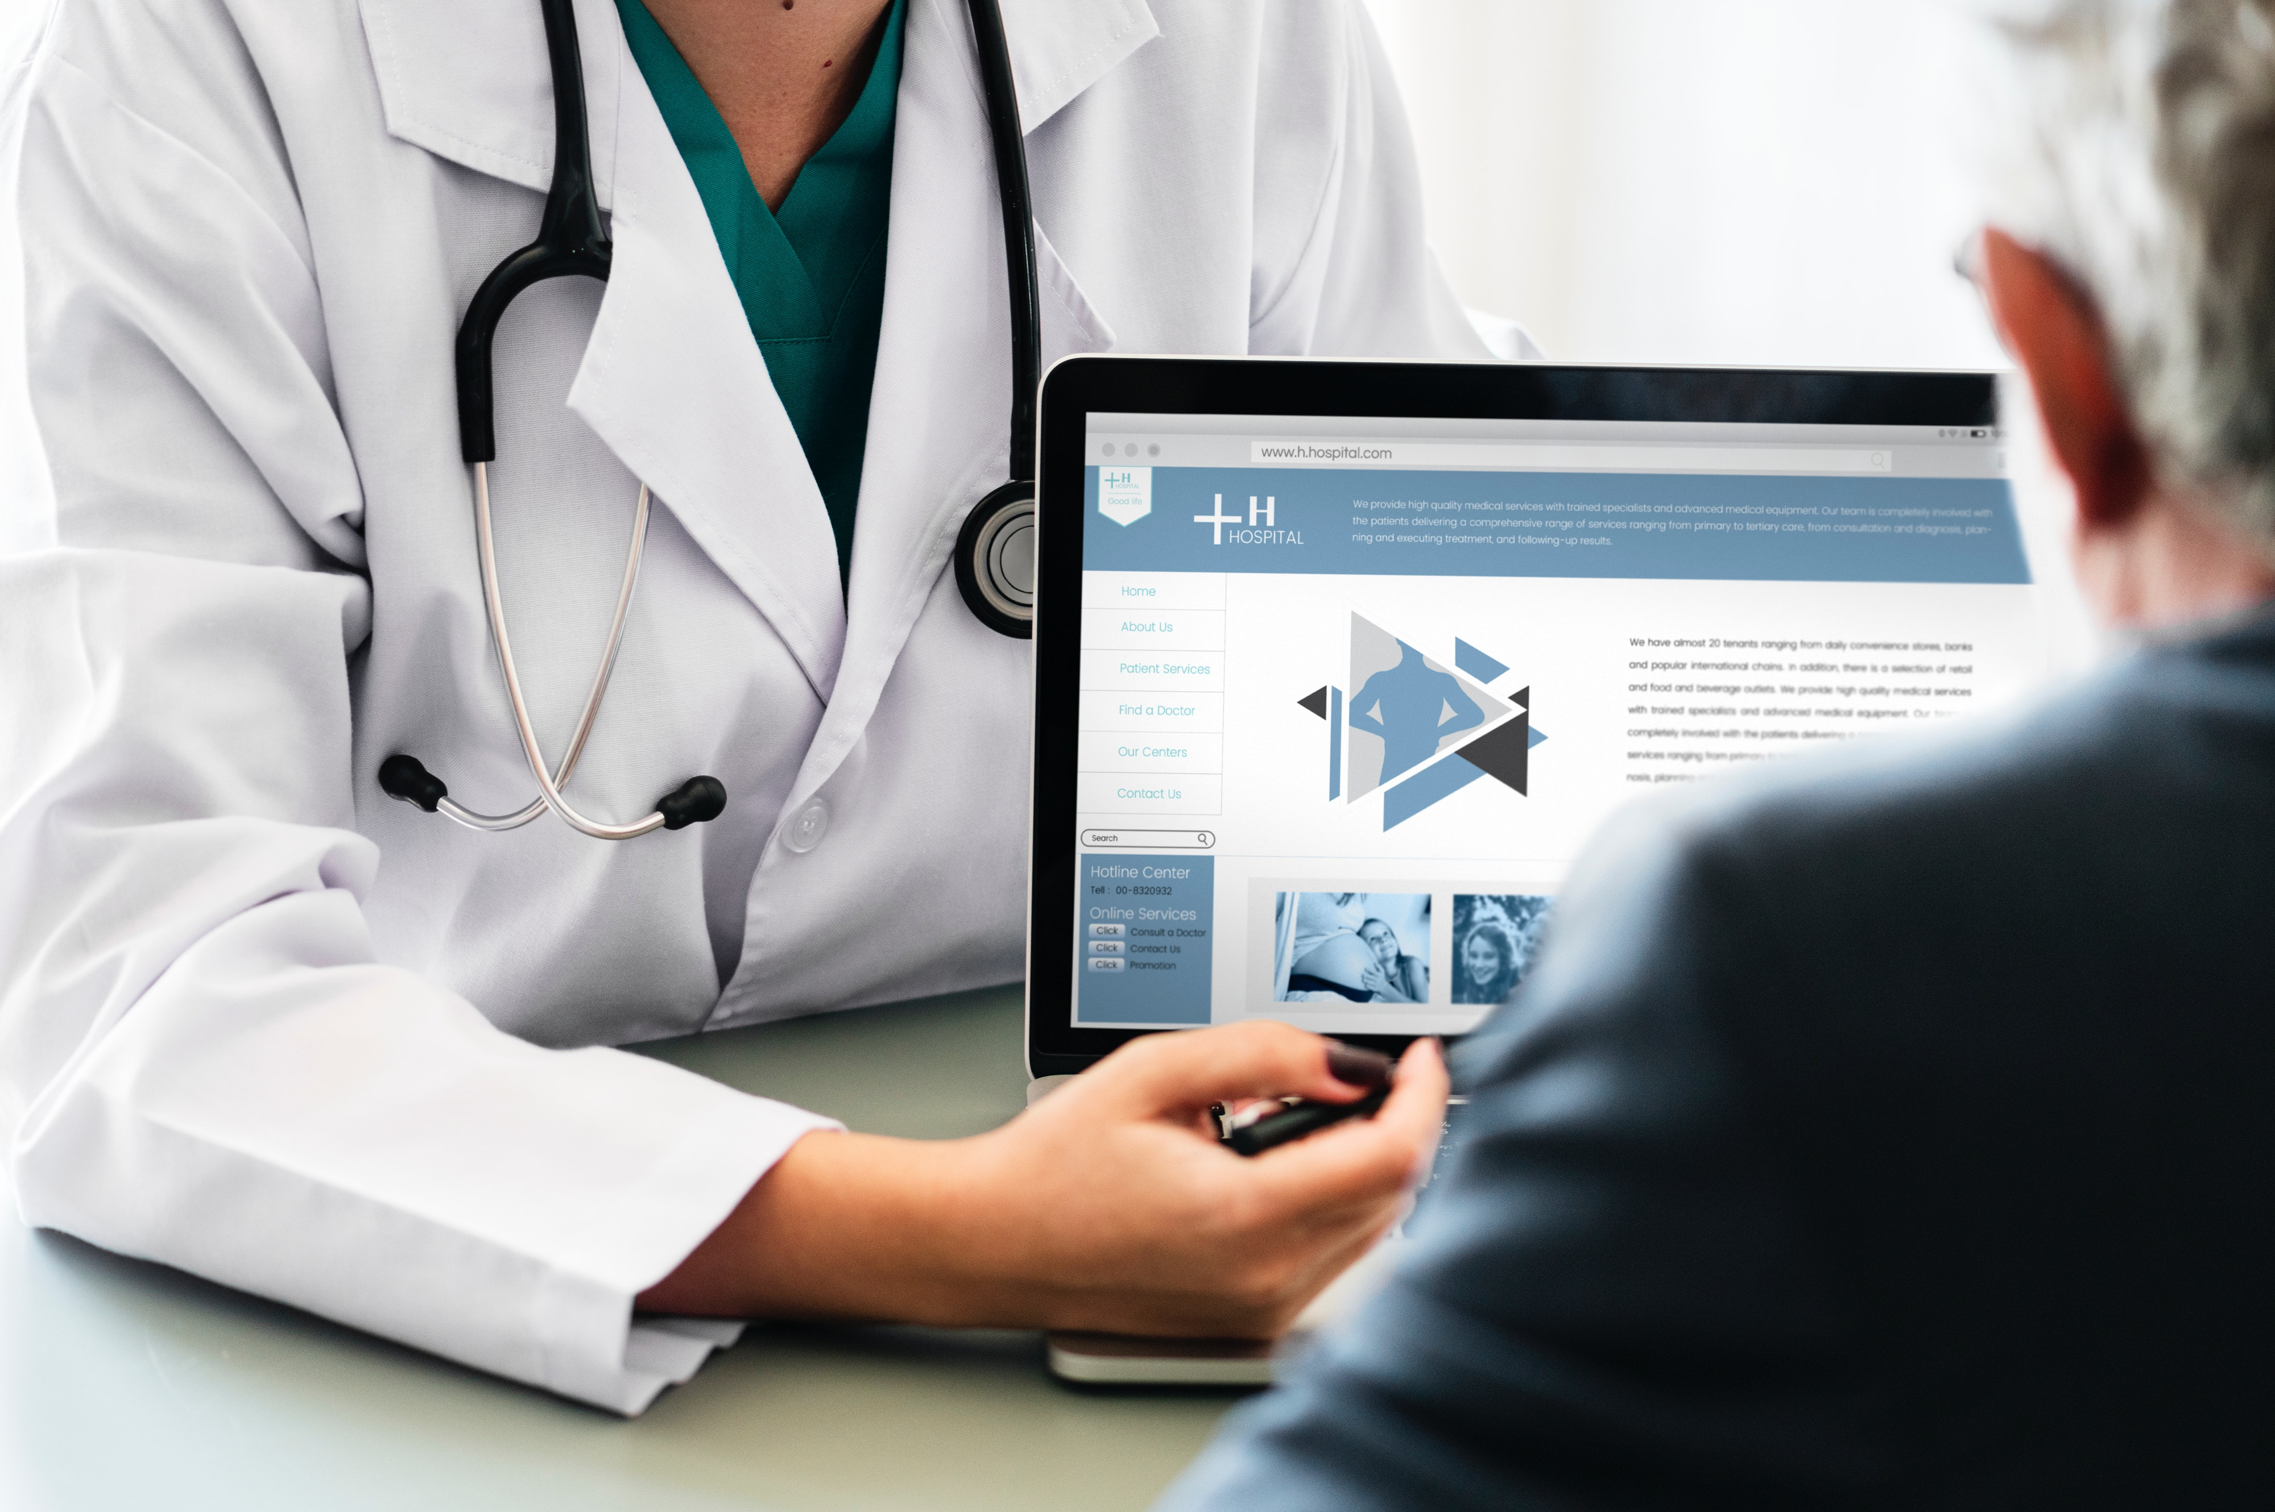
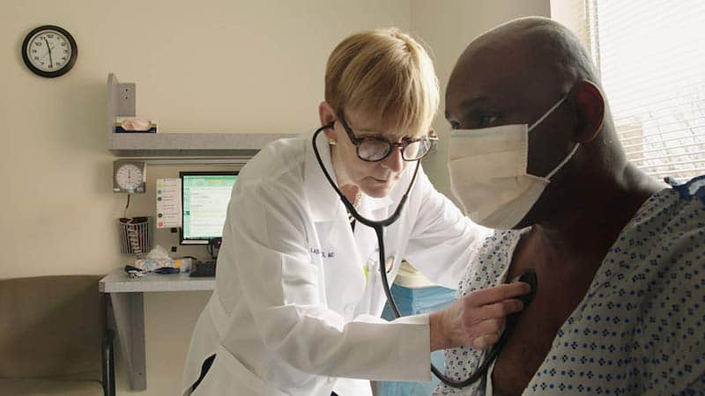
The main mantra to maintain healthy and nurturing relationships is effective communication.

Slide 4
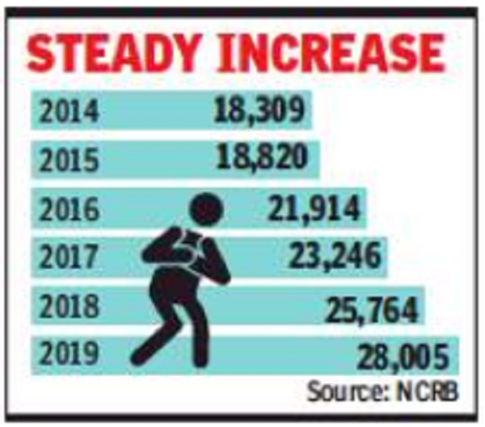

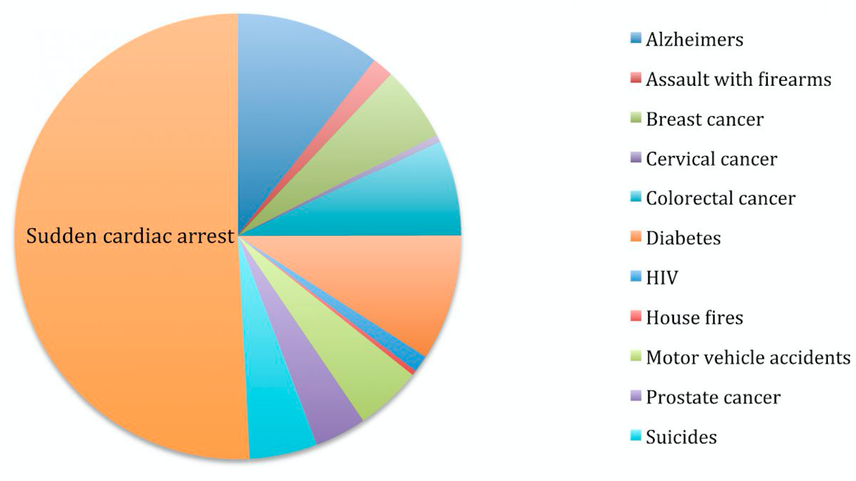
Approach Details
Cardiovascular diseases (CVDs) are the leading cause of death globally, taking an estimated 17.9 million lives each year, representing 32% of all global deaths
It is important to detect cardiovascular disease as early as possible so that management with counselling and medicines can begin. Cardiovascular disease (CVD) still remains the main cause of morbidity and mortality and consequently, early diagnosis is of paramount importance.
To cater this, we have come up with a solution to early diagnose cardiomegaly disorder and reduce the mortality rate.
We have build a model to diagnose Cardiomegaly from digital chest X-Ray images. We are using Resnet over U-Net model to build segmentation models to calculate cardiothoracic ratio ( CTR) for assessment of Cardiomegaly in CXR images.
CTR of a chest X-ray image is calculated as cardiac diameter (the diameter of the heart) divided by the thoracic diameter (the diameter of the chest). The predicted results will help in identifying the cardiomegaly disorder.

Slide 5
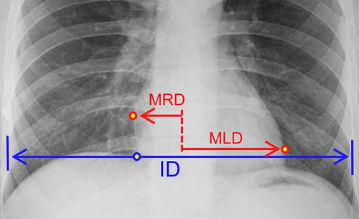
Technology Stack
ML Modules
Lung Segmentation – ResUnet for Image Segmentation
Image processing - opencv Library
Constructing the ML model- Tensorflow & Keras
Matplotlib – for data Visualization
Pil image module : Python Imaging Library which provides the python interpreter with image editing capabilities
Albumentations: Python library for image augmentation. Image augmentation is used in deep learning and computer vision tasks to increase the quality of trained models
2. User Interface – React js, redux, tailwind
3. Backend – Node.js, Express.js, Python, Flask
4. Database: Mongo db nosql database

Slide 6
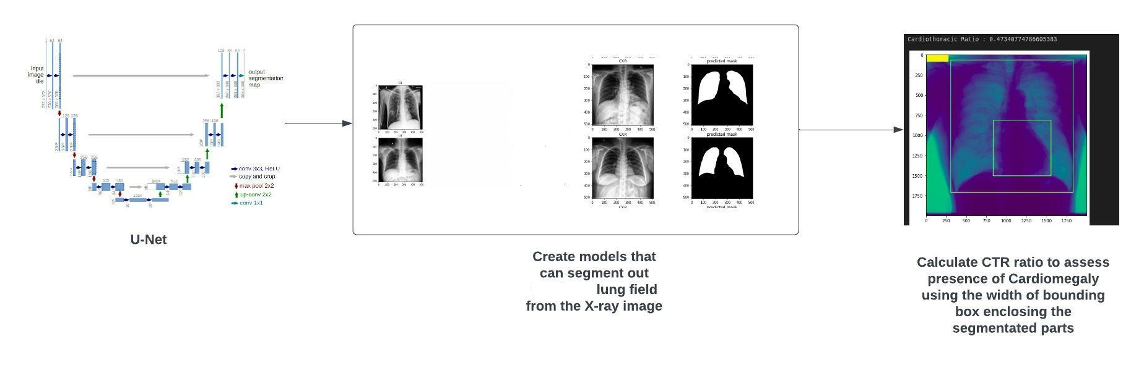
Model Building
ResNet over Unet is the model that we used for image Segmentation
It is popular biomedical image segmentation network and does pixel wise segmentation over great speed .
It has end to end encoder and decoder network. Encoder is used for feature extraction from digital chest x-ray input and Decoder processes features into output mask.
The Dataset used for our model is National Institutes of Health Chest X-Ray Dataset
NIH Chest X-rays dataset has over 112,000 Chest X-ray images from more than 30,000 unique patients

Slide 7

The Hourglass Network – FCN , UNET & VNET
Fully Convolutional Network (FCN) up samples only once. i.e. it has only one layer in the decoder whereas UNET has multiple up sampling layers
In UNET’s each upward layer, the previous output gets up sampled and de-convoluted, to then get combined with the output of the corresponding layer in the downward path
FCN uses bilinear interpolation for up sampling the convolved image. That is there is no learnable filter here. UNET uses skip connections and concatenates instead of adding up.
UNET uses learnable weight filters instead of fixed interpolation technique.
VNET exploits a fully-convolutional structure, with the presence of convolution operations exclusively and the absence of pooling layers
Following are the 2 reasons for using VNET over any other network model:
The pooling can easily be substituted by a convolution with a larger stride, resulting in networks that are faster to train.
Secondly, applying the corresponding up sampling operation in the expanding path is easier and so de-convolutions are preferred to un-pooling for ease of understanding and analysis.

Slide 8
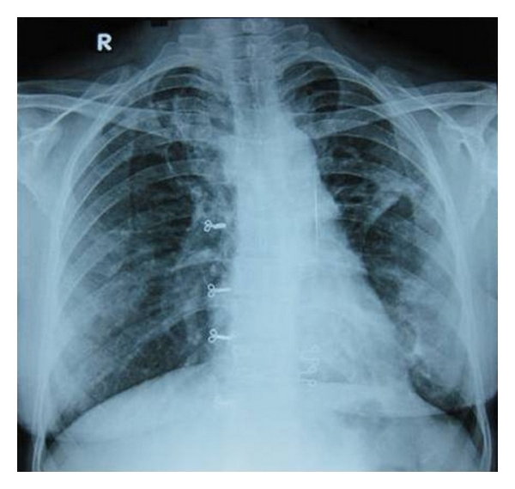
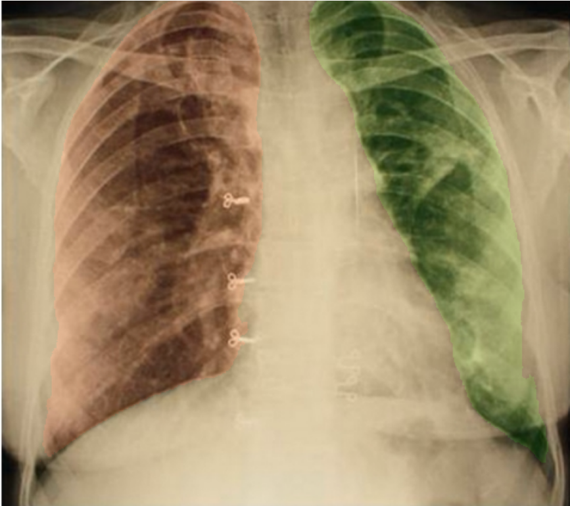
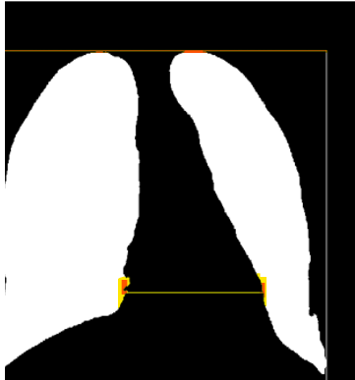
Cardio Thoracic Ratio (CTR) Calculation
ID
MRD
MLD
CTR = (MRD + MLD) / ID
where ,
ID = Internal Diameter of chest
MRD = the midline-to-right heart diameter
MLD= the midline-to-left heart diameter
CTR < 0.50 no cardiomegaly detected
CTR (0.5 , 0.55) mild cardiomegaly detected
CTR > 0.55 CARDIOMEGALY DETECTED

Slide 9
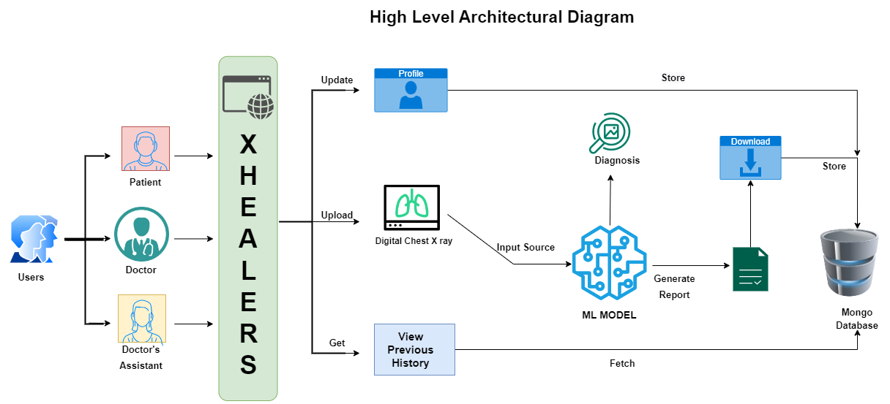

Slide 10

Revenue Sales Production Proposal
Why X-Healers?
According to WHO, Cardiovascular diseases (CVDs) is the leading cause of death globally, taking an estimated 17.9 million lives each year, representing 32% of all global deaths
Hospital Statistics strongly indicate a considerable increase in the number of deaths caused by heart diseases, specifically Cardiomegaly over the past decades, hence X-Healers helps detect Cardiomegaly at an earlier stage to help prolong a patient health through earlier medication treatment.
Facilitating heart disease diagnosis through technological advancements, making X-Healers an adequate solution for Cardiomegaly heart detection.
Budget Income Planning
After the launching of web App X-Healers the following are the expectations :
The normal Xray charges ranges from 350 INR – 750 INR
The average consultation fee is INR 500- 1000
Average total spends = INR 850-INR 2000
Our web app trims off the Consultation fee to just INR 100
Total spends = 350+100 ~500
The cost is reduced by 1/4th the avg total spends without our app

Slide 11

Advantages
Our web application has three layer architecture – Business Layer, Database Layer and Client Layer. Thus, ensuring data independency and modularity.
Security of web application is done through JWT Token Based Authentication.
Maintenance of user profile for role based access.
Auto login feature is also enabled if user logins after long period of time
Validation of various fields is done with proper display messages and prompts
The patient historical data is stored and this can be a boon in monitoring patients health and progress. Thus saving patient’s life.

Slide 12

Future Scope
Currently our application only focuses on English Language. In future we will try to incorporate other dialects also.
For global enhancement, we will deploy our web application on Netlify or Hostinger and backend over Heroku or AWS. This will ensure high throughput and low latency.
To maintain proper traffic balance over web application, we will be using Microservices and Container based applications
Currently our model is not utilizing the captured symptoms. In future we will use these parameters to increase model accuracy.
Currently our model uses UNET, but VNET is faster and easier to train the model. Hence in future, we will consider various other network model architecture.

Slide 13


